Slide 1
IBM University Engagement Project Submission
“Exploring the Power of Agentic AI with IBM Granite and IBM Bob”

Slide 2
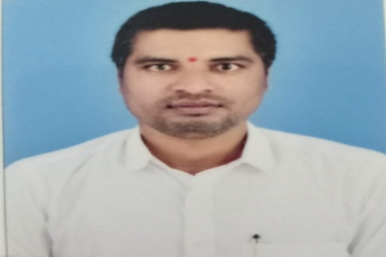
Project Tile – Intelligent Crop Marketing Assistant (Market Agent + Decision Agent)
Domain of Project – Artificial Intelligence (AI) – Agentic AI for Smart Agriculture (AgriTech)
Student Name | Recent Passport Photo | Email ID | Mobile number [WhatsApp]
BURRA RAJU |  | rajuecefdp@gmail.com | 9014434222
Recommended font style and size: Font Style: Arial Font Size (Heading): 28
Font Size (Content): 20

Slide 3
Problem Statement -
The Challenge
Farmers often sell their crops without access to real-time market information, resulting in lower profits and poor selling decisions. Fluctuating market prices, transportation costs, demand trends, and government procurement policies make it difficult to identify the best market and selling time. An AI-powered solution is needed to provide personalized, data-driven recommendations that help farmers maximize their income.
The Objective
Develop AgriMarket AI, an Agentic AI Crop Marketing Assistant using IBM watsonx.ai Granite Models, IBM Bob (watsonx Orchestrate), and IBM Cloud. The solution uses two AI agents: a Market Intelligence Agent to collect real-time crop prices, demand trends, and government schemes, and a Decision Agent to analyze transportation costs, price forecasts, and market conditions to recommend the optimal market, selling time, and pricing strategy. The application delivers transparent insights through an interactive dashboard, enabling farmers to make informed decisions and improve profitability.

Slide 4
Proposed Solution -
Proposed Solution: AI-Powered Intelligent Crop Marketing Assistant
The proposed solution is a multi-agent AI-powered Intelligent Crop Marketing Assistant built using IBM Bob, IBM watsonx.ai, and Granite Models to provide personalized, real-time market intelligence and crop-selling recommendations. The system addresses the challenges of market price fluctuations, lack of reliable agricultural information, and poor marketing decisions through an intelligent, modular architecture.
At its core, the solution uses a Retrieval-Augmented Generation (RAG) pipeline to fetch accurate agricultural data from trusted sources such as AGMARKNET, eNAM, Government Agricultural Portals, IMD Weather Services, and Ministry of Agriculture datasets. This information is embedded and stored in a vector database, enabling the system to retrieve and summarize crop prices, market trends, weather forecasts, government schemes, and Minimum Support Price (MSP) information using Granite Models.
The system consists of two key agents:
Market Agent retrieves and analyzes real-time crop prices, market demand, weather conditions, MSP details, government schemes, and market intelligence using the RAG framework. It continuously monitors agricultural markets and provides accurate, up-to-date information to farmers.
Decision Agent generates personalized crop marketing recommendations based on farmer location, crop type, quantity, transportation cost, storage availability, historical price trends, and current market conditions. It recommends the optimal market, best selling time, and pricing strategy to maximize farmers' profits while minimizing risks.
The solution includes a user-friendly dashboard (built with Streamlit or React) that visualizes real-time crop prices, historical price trends, demand forecasts, weather conditions, recommended markets, expected profits, transportation costs, and personalized marketing insights through interactive charts and reports.
IBM Bob is used to orchestrate the workflows between the Market Agent and Decision Agent, ensuring seamless coordination and intelligent task execution. IBM watsonx.ai provides scalable AI model deployment, embeddings, vector search, and AI governance, while Granite Models power reasoning, summarization, market analysis, and personalized recommendation generation.

Slide 5
Technology Used
IBM Bob platform -For designing and orchestrating multi-agent workflows visually
IBM Grainte model - for eg – ibm-granite-3-2-8b – For natural language understanding, reasoning, and personalization
IBM Cloud – It provides the infrastructure to build, deploy, and scale the Nutrition Agent efficiently. IBM Cloud enables a reliable, secure, and scalable environment for deploying the Nutrition Agent.
IBM Watsonx.studio, Watsonx Run time, cloud object storage – for creating new project on IBM cloud.
Prompt Engineering – for defining the goal of the Agent.

Slide 6
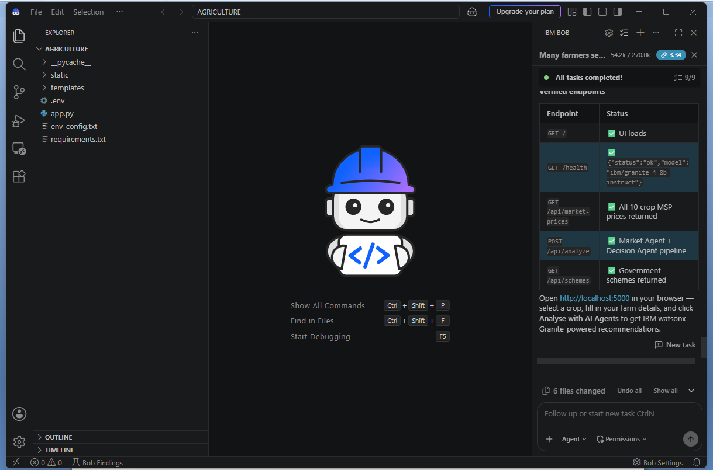
Required Files created using IBM bob -
_pycache_
Static
templates
.env
app.py
env_config.txt
requirements.txt

Slide 7
IBM Bob Screenshots:

Slide 8
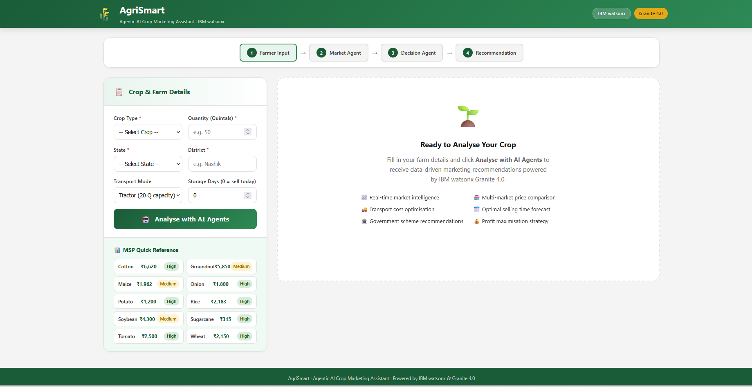
User Interface For Intelligent Crop Marketing Assistant

Slide 9
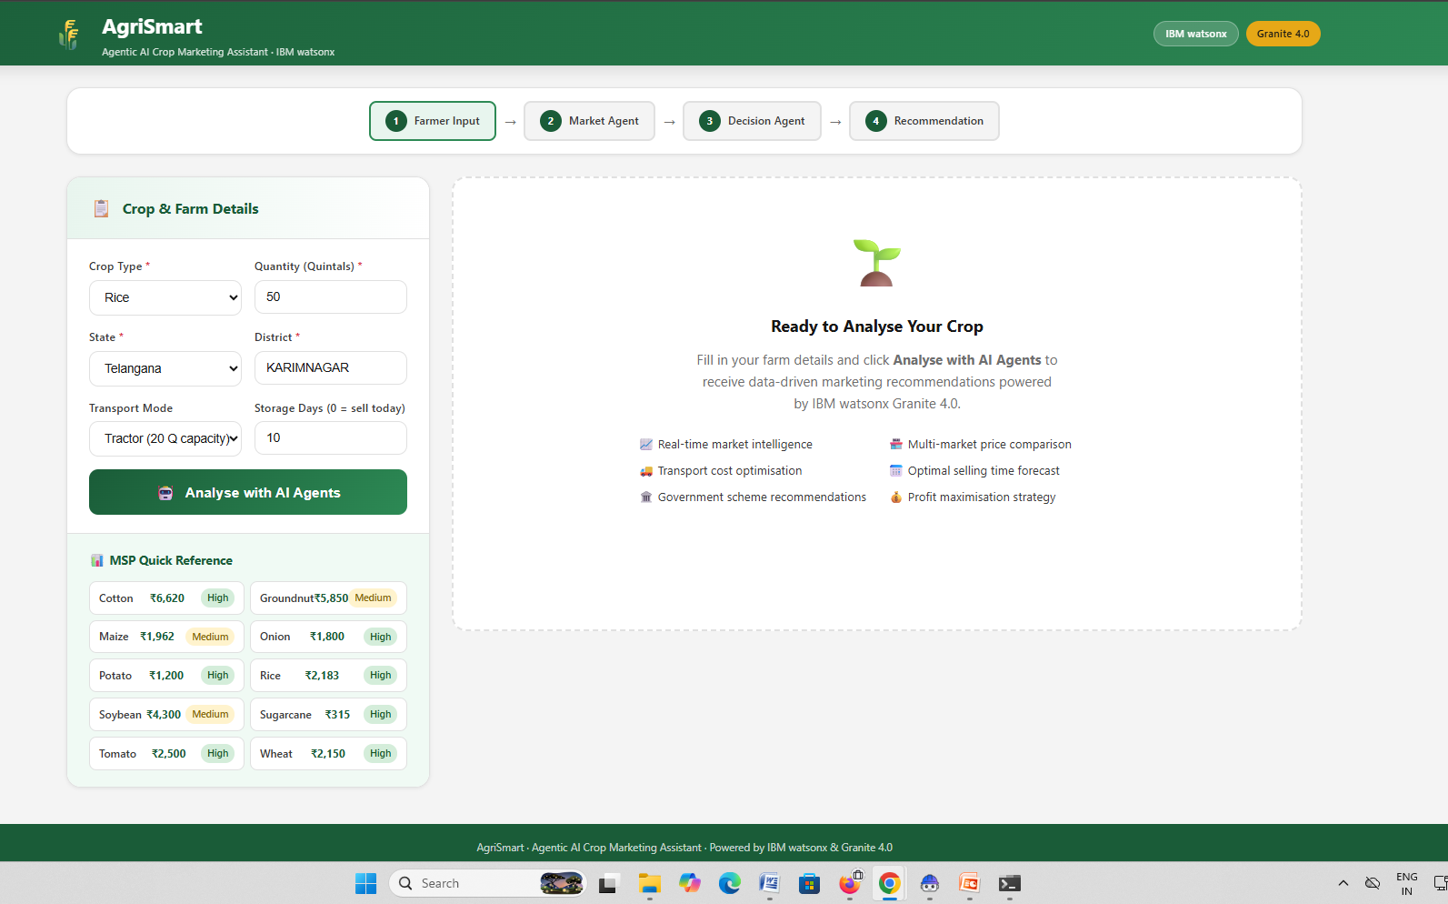
User Prompt For Intelligent Crop Marketing Assistant

Slide 10
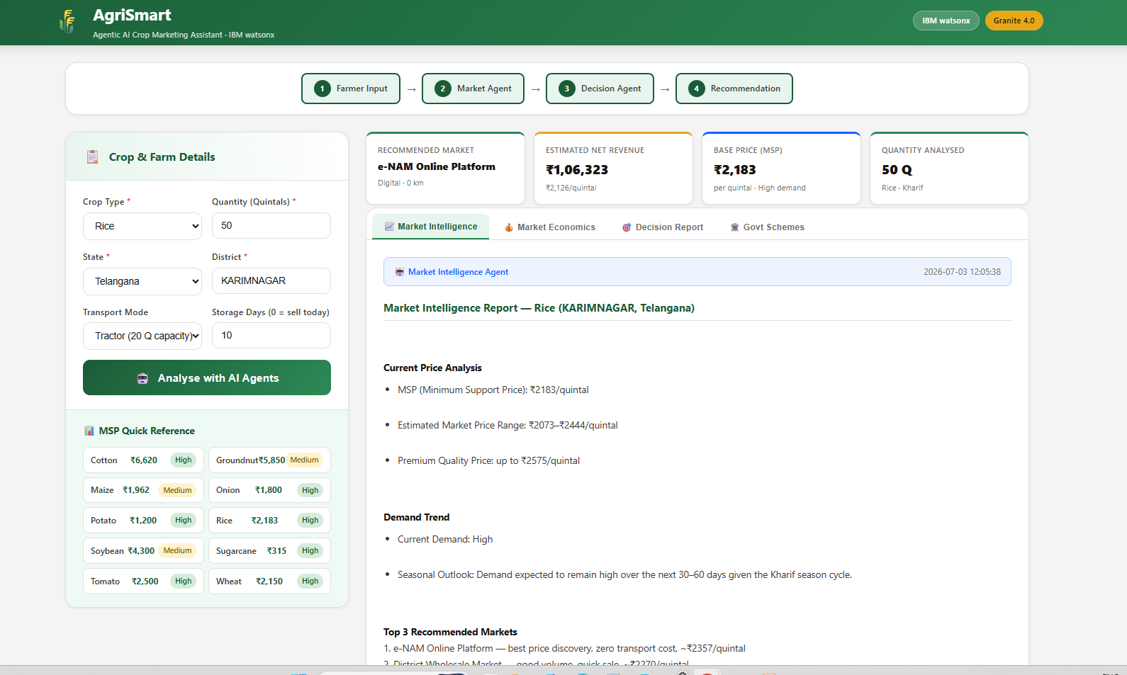
Intelligent Crop Marketing Assistant Response

Slide 11
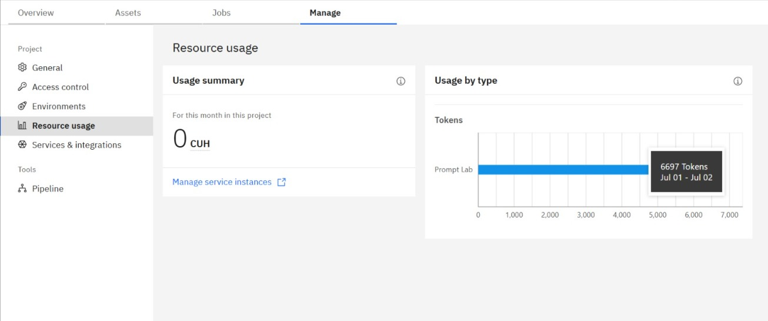
Token Usage/Resource Consumption Intelligent Crop Marketing Assistant
·
·
·

Slide 12
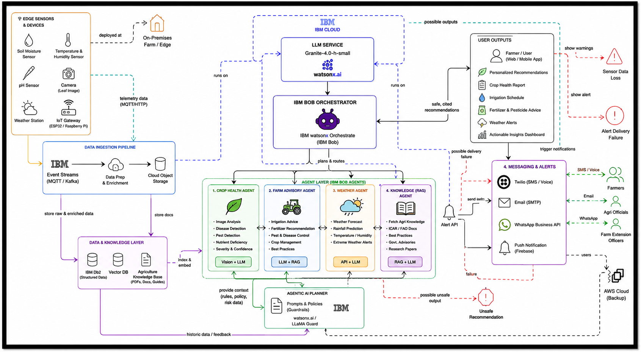
Architecture blueprint for IBM bob for Intelligent Crop Marketing Assistant
Please put IBM Bob output screenshots with 2-3 prompts.
You can take 2-3 more slides for each screenshot
·
·
·

Slide 13
Novelty and Uniqueness
The proposed Nutrition Agent stands out by combining Agentic AI, RAG, and personalization into a single intelligent system.
Multi-Agent Intelligence – Instead of a single chatbot, multiple specialized agents collaborate to deliver accurate and context-aware nutrition guidance.
RAG-Based Accuracy – Integrates real-time data retrieval with AI generation, reducing misinformation and ensuring trustworthy recommendations.
Hyper-Personalization – Tailors diet plans based on health conditions, cultural preferences, and fitness goals.
Real-Time Feedback Loop – Continuously adapts recommendations based on daily food logs and user behavior.
Multi-Modal Input – Supports text, voice, and image-based meal tracking for better usability.
Preventive Healthcare Focus – Goes beyond diet planning to provide disease-specific nutrition advice.
Scalable & Enterprise-Ready – Built on IBM watsonx.ai with IBM Granite models, ensuring reliability and governance.
This makes the solution a smart, adaptive, and proactive digital nutritionist, not just a static diet recommendation tool.

Slide 14
Git Hub Link
https://github.com/rajuecefdp-maker/Intelligent-Crop-Marketing-Assistant.git
1. Generative AI in Action Credly Certificate
2. IBM BOB Certificate
3. PPT
4. Problem Statement
·
·
·

Slide 15
Future Scope
AI Price Forecasting – Predict future crop prices using historical data, weather, and demand trends.
IoT Integration – Use smart sensors for real-time farm, soil, and weather monitoring.
Multilingual Voice Support – Enable voice-based assistance in regional languages for better accessibility.
Blockchain Traceability – Ensure transparent and secure farm-to-market supply chain tracking.
Direct Buyer Marketplace – Connect farmers directly with buyers, retailers, and exporters.
Government Integration – Provide real-time access to MSP, subsidies, crop insurance, and agricultural schemes.
Scalable AI Platform – Expand to support multiple crops, regions, and international markets using IBM Cloud.
Future Vision: Transform AgriMarket AI into a comprehensive AI-powered digital agriculture platform that empowers farmers with predictive insights, intelligent decision-making, and sustainable, profitable farming.
·
·
·

Slide 16
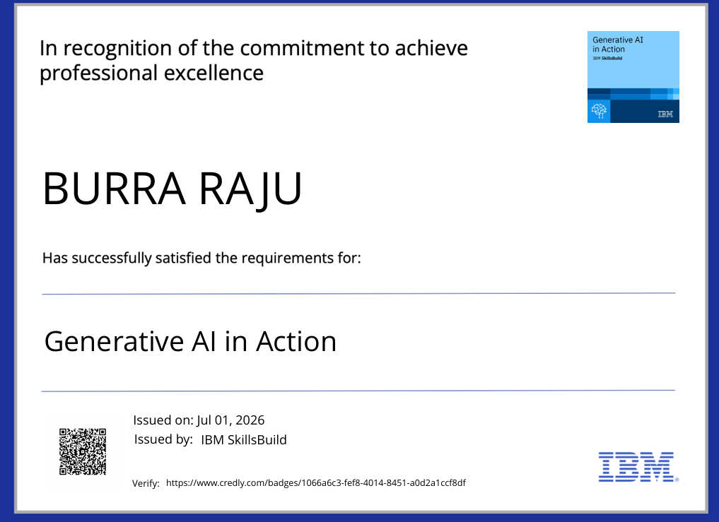
Certificates Earned:

Slide 17
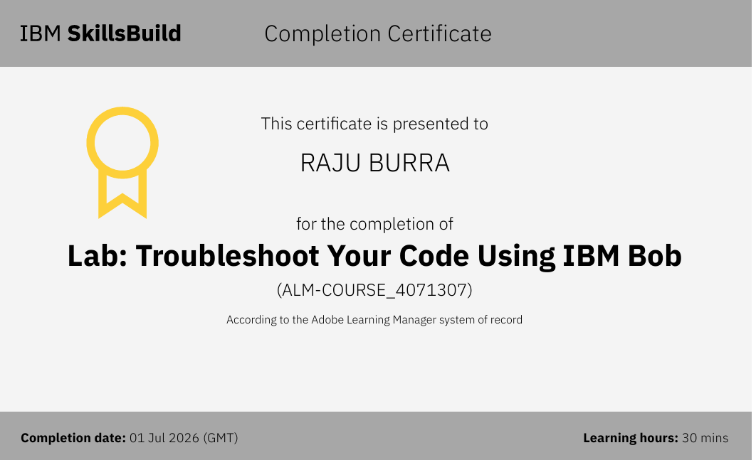
Certificates Earned:​

Slide 18
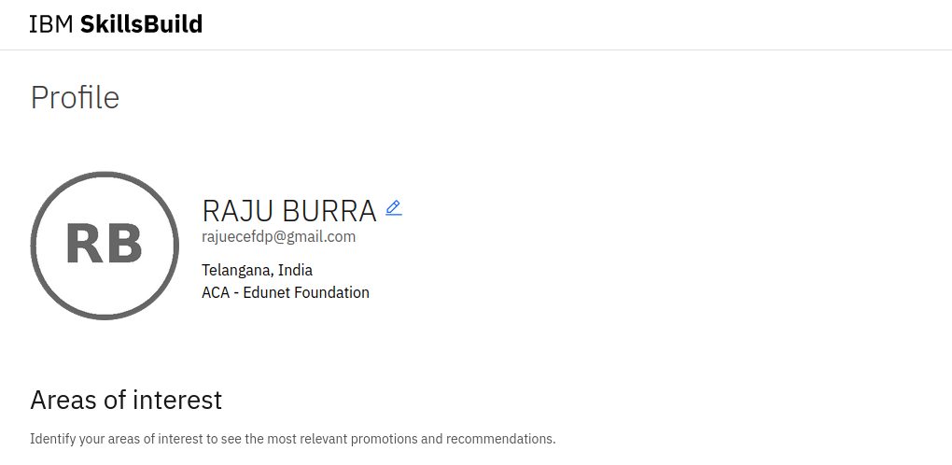
IBM SKILLS BUILD PROFILE

Slide 19


